Slide 1

SCRAPE DATA FROM THE WEB

Slide 2
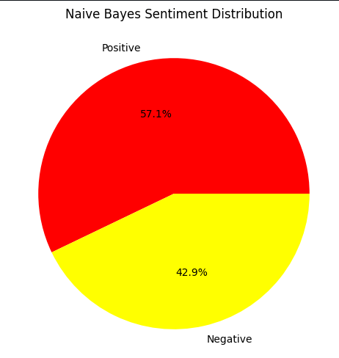
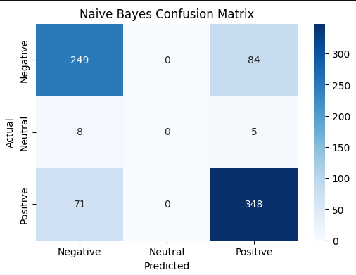
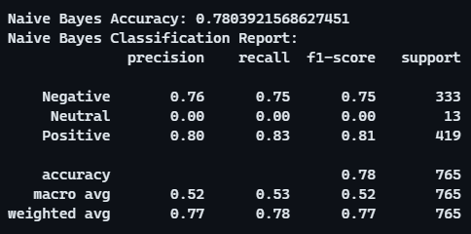
CUSTOMER REVIEWS
From cleaning 3500+ reviews given by the customers, we obtained
Positive Reviews - 2192
Negative Reviews - 1571
Neutral Reviews - 59

